Slide 1
Decision Tree Regression
Akhilesh Joshi

Slide 2
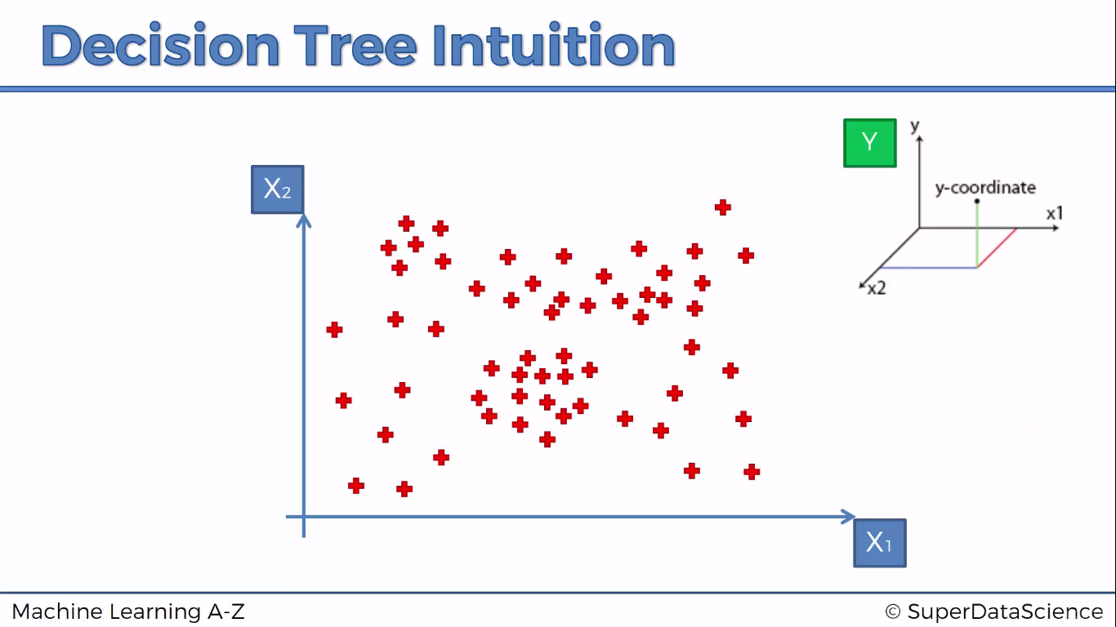

Slide 3
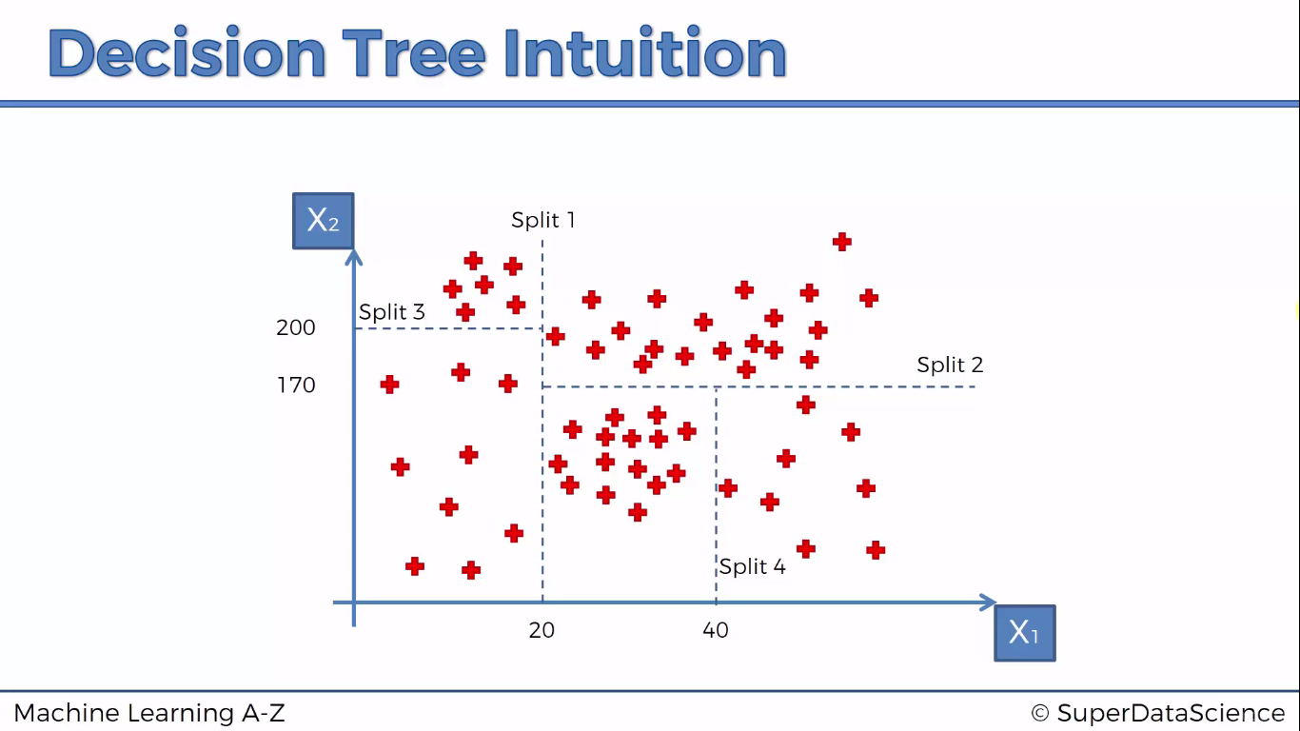

Slide 4
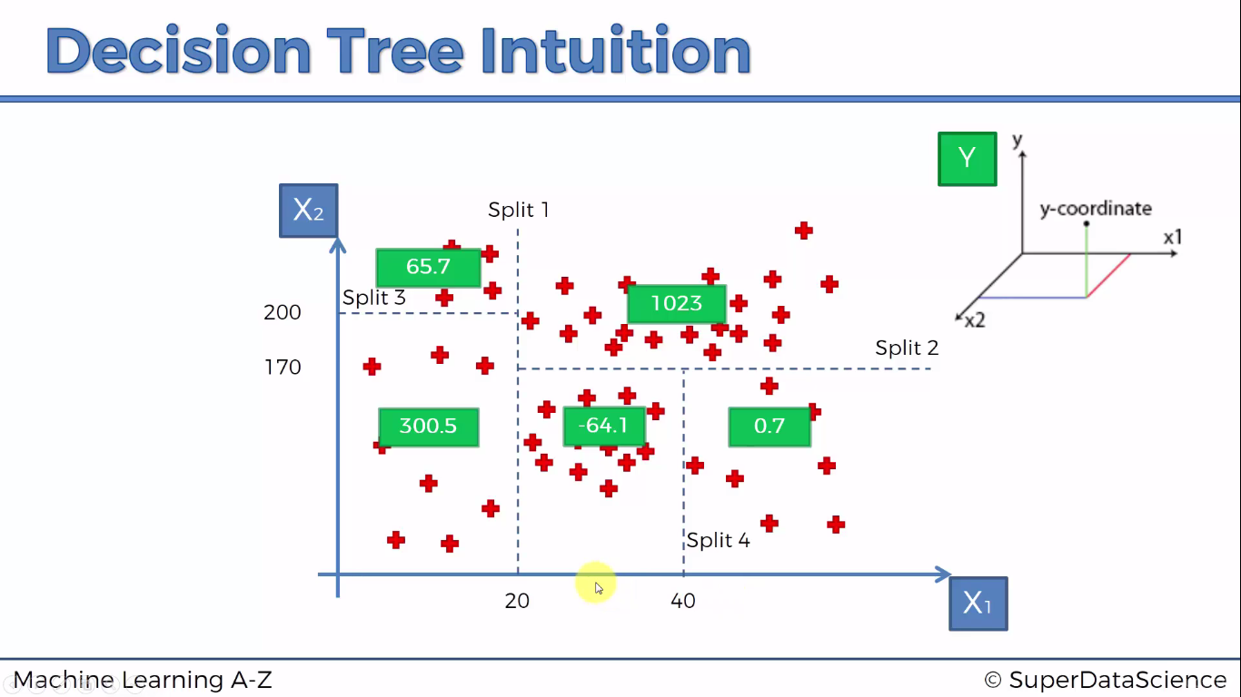
The value in green box represents the average of data points in that split

Slide 5
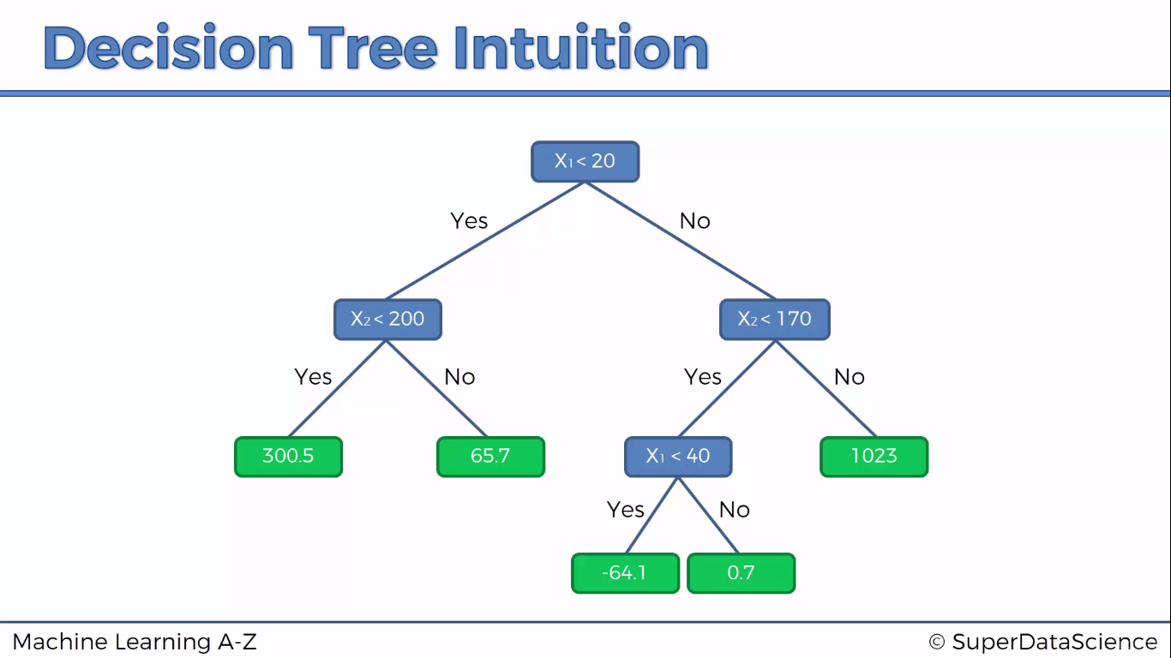

Slide 6
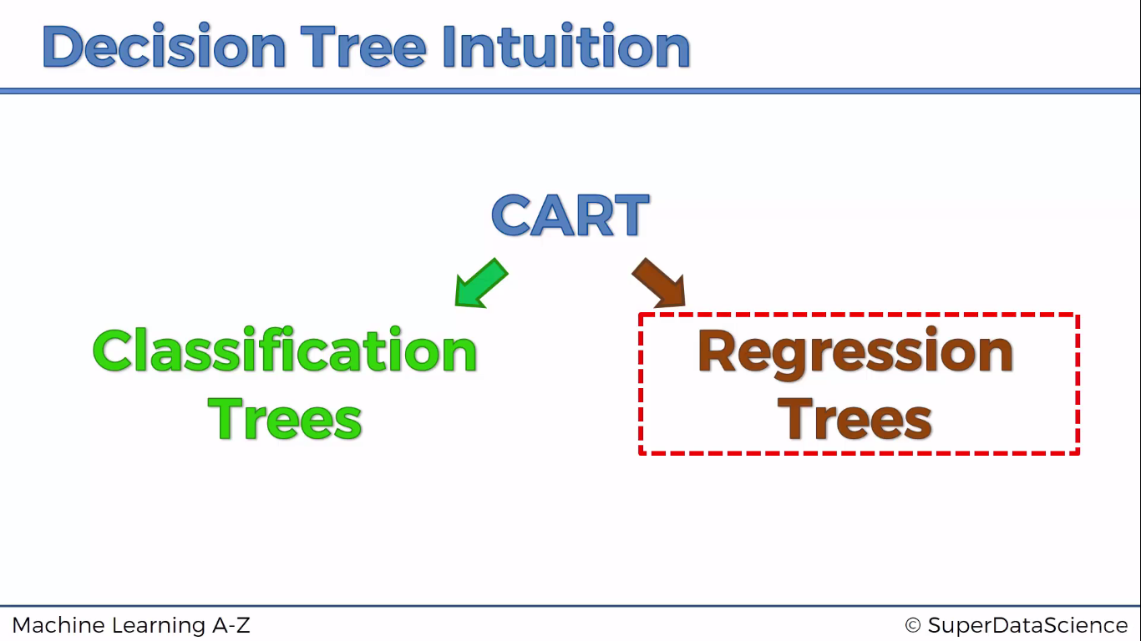

Slide 7

Python

Slide 8
Reading file dynamically
from tkinter import *
from tkinter.filedialog import askopenfilename
root = Tk()
root.withdraw()
root.update()
file_path = askopenfilename()
root.destroy()

Slide 9
Importing Libraries
import pandas as pd
import numpy as np
import matplotlib.pyplot as plt

Slide 10
Importing dataset
dataset = pd.read_csv(file_path)
X= dataset.iloc[:,1:2].values
y= dataset.iloc[:,2:3].values

Slide 11
Decision Tree Regressor
from sklearn.tree import DecisionTreeRegressor
regressor = DecisionTreeRegressor(random_state=42)
model = regressor.fit(X,y)

Slide 12
Prediction
model.predict(6.5)

Slide 13
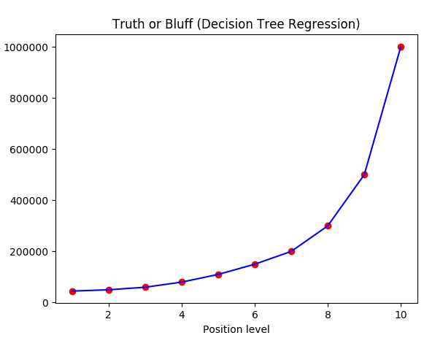
Simple PLOT
plt.scatter(X,y,color="red")
plt.plot(X,model.predict(X),color="blue")
plt.title('Truth or Bluff (Decision Tree Regression)')
plt.xlabel('Position level')
plt.ylabel('Salary')
plt.show()
NOTE : Whats wrong here ? Well in the simple plot the Decision Tree Regressor model is treated as a continuous model
But it is not a continuous model. Decision Tree Regressor is a discrete model hence it should be treated as discrete.
FIX : plotting the same graph with grid with small step size say 0.01 will help us visualize better

Slide 14
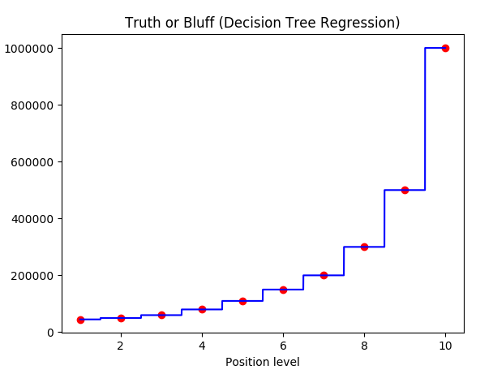
Updated PLOT
X_grid = np.arange(min(X), max(X), 0.001)
X_grid = X_grid.reshape((len(X_grid), 1))
plt.scatter(X, y, color = 'red')
plt.plot(X_grid, regressor.predict(X_grid), color = 'blue')
plt.title('Truth or Bluff (Decision Tree Regression)')
plt.xlabel('Position level')
plt.ylabel('Salary')
plt.show()
Note : Here the graph that is plotted gives us the clear discrete structure

Slide 15

R

Slide 16
Read dataset
library(readr)
dataset <- read_csv("D:/machine learning AZ/Machine Learning A-Z Template Folder/Part 2 - Regression/Section 7 - Support Vector Regression (SVR)/SVR/Position_Salaries.csv")
dataset= dataset[2:3]

Slide 17
Library Required - Rpart
library('rpart')
regressor = rpart(Salary ~ . , data= dataset , control = rpart.control(minsplit = 1))
NOTE : do not forget to include control parameter as it decides the number of splits in your model.

Slide 18
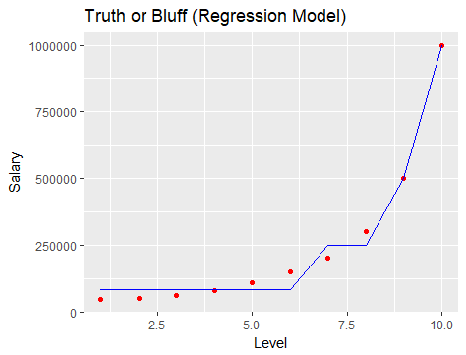
Plot
# Visualising the Regression Model results
# install.packages('ggplot2')
library(ggplot2)
ggplot() +
geom_point(aes(x = dataset$Level, y = dataset$Salary),
colour = 'red') +
geom_line(aes(x = dataset$Level, y = predict(regressor, newdata = dataset)),
colour = 'blue') +
ggtitle('Truth or Bluff (Regression Model)') +
xlab('Level') +
ylab('Salary')
Here model is not treated as discrete hence plot simply joins the prediction points since we don’t have any predictions for this interval.
Solution : plot Level as grid with step size as small as 0.01 or whatever you want it to be

Slide 19
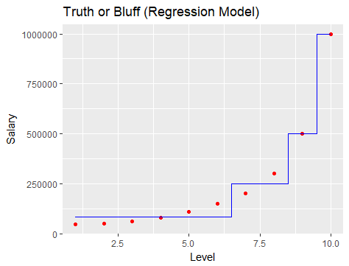
Smoother PLOT
# install.packages('ggplot2')
library(ggplot2)
x_grid = seq(min(dataset$Level), max(dataset$Level), 0.001)
ggplot() +
geom_point(aes(x = dataset$Level, y = dataset$Salary),
colour = 'red') +
geom_line(aes(x = x_grid, y = predict(regressor, newdata = data.frame(Level = x_grid))),
colour = 'blue') +
ggtitle('Truth or Bluff (Regression Model)') +
xlab('Level') +
ylab('Salary')
PERFECT PLOT

Slide 20
Predictions
prediction = predict(regressor,data.frame(Level=6.5))

